Slide 1
LENDING CLUB CASE STUDY
Group Members:
Aakash Sharma
Sweta Samant

Slide 2
Abstract
Lending Club is a marketplace for personal loans that matches borrowers who are seeking a loan with investors looking to lend money and make a return. When the company receives a loan application, the company has to make a decision for loan approval based on the applicant’s profile.
Two types of risks are associated with the bank’s decision:
• If the applicant is likely to repay the loan, then not approving the loan results in a loss of business to the company
• If the applicant is not likely to repay the loan, i.e. he/she is likely to default, then approving the loan may lead to a financial loss for the company
So, company wants to understand the driving factors (or driver variables) behind loan default, i.e. the variables which are strong indicators of default. The company can utilize this knownledge for its portfolio and risk assessment.

Slide 3
PROBLEM SOLVING METHODOLOGY
Data Understanding
Data Dictionary Understanding
Know domain specific uses
Data Cleaning
Removing Null values
Derived variables
Univariate Analysis
Analysis each column
Plot distribution
Recommendations
Segmented Univariate Analysis
Bivariate Analysis
Analysis continuous data column w.r.t categorical column
Analysis two variable behaviour
Provide recommendation after Analysis

Slide 4
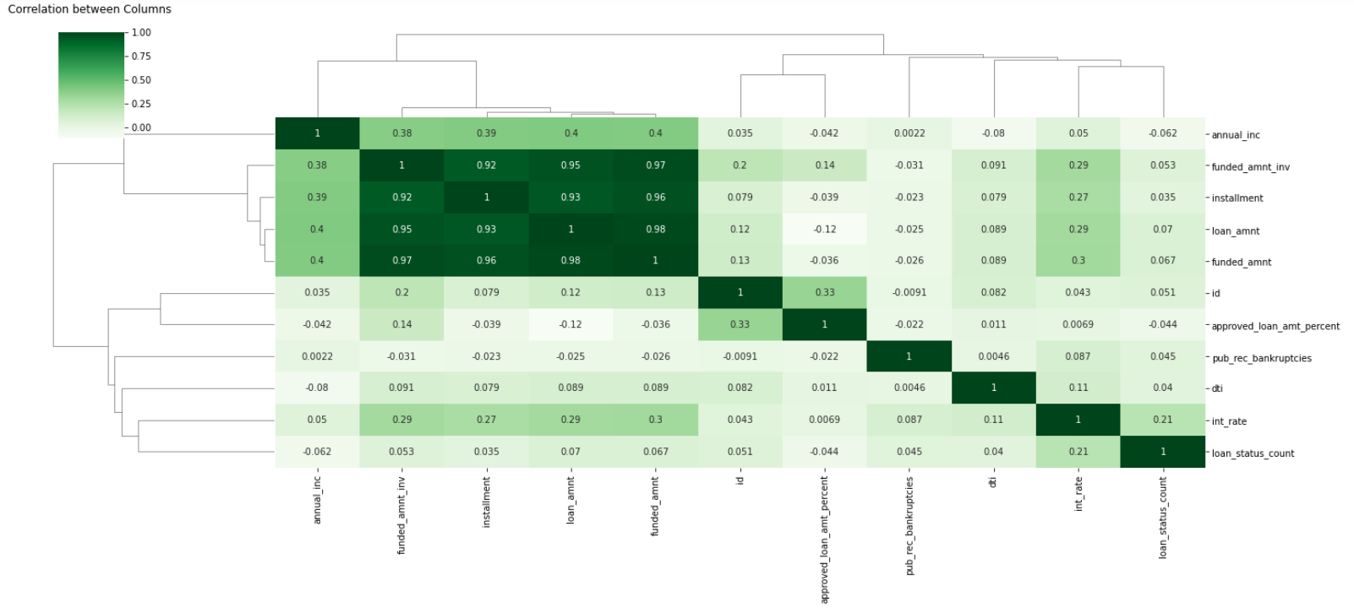
Analysis
loan_amnt , funded_amnt , funded_amnt_inv , installment are strongly correlated.
annual_inc and dti is negatively correlated.
Debt income ratio is the percentage of a borrower's monthly gross income that goes toward paying debts.
Which means when annual_inc is low, debt is high and vice versa.
Interest Rate wont much impact on loan_amnt , funded_amnt , funded_amnt_inv , installment.
loan_amnt , funded_amnt , funded_amnt_inv , installment is dependent on Annual Income.

Slide 5
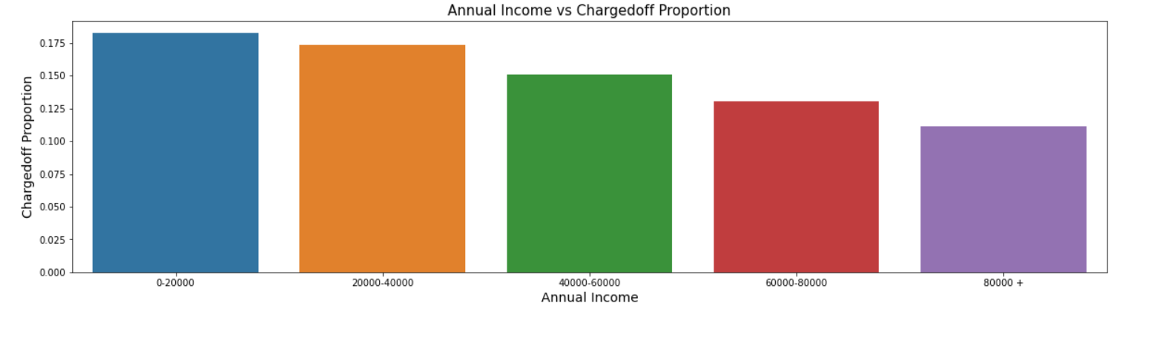
Analysis
Annual income is increasing charged off proportion is decreasing.
So highest charged off proportion are in the range between 0 to 20k annual income.

Slide 6
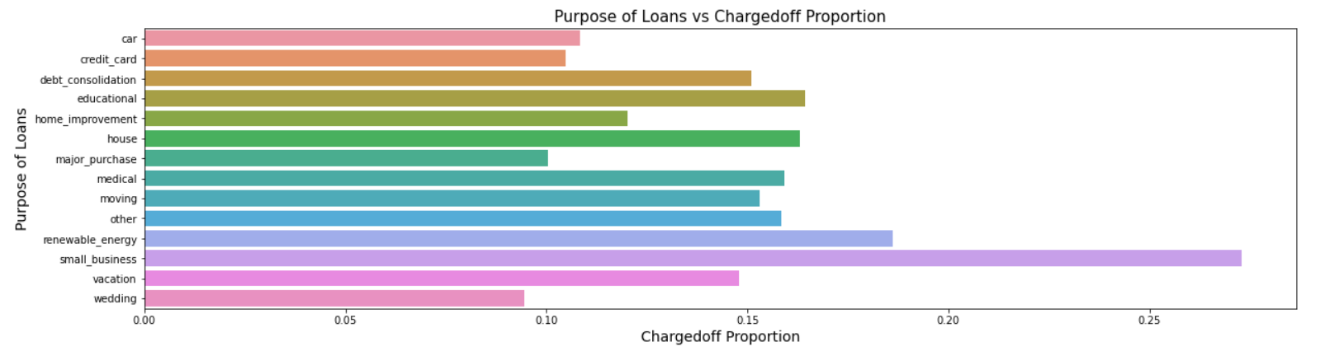
ANALYSIS
The borrower who take loan for the purpose of small-business has the maximum charged off proportion.

Slide 7
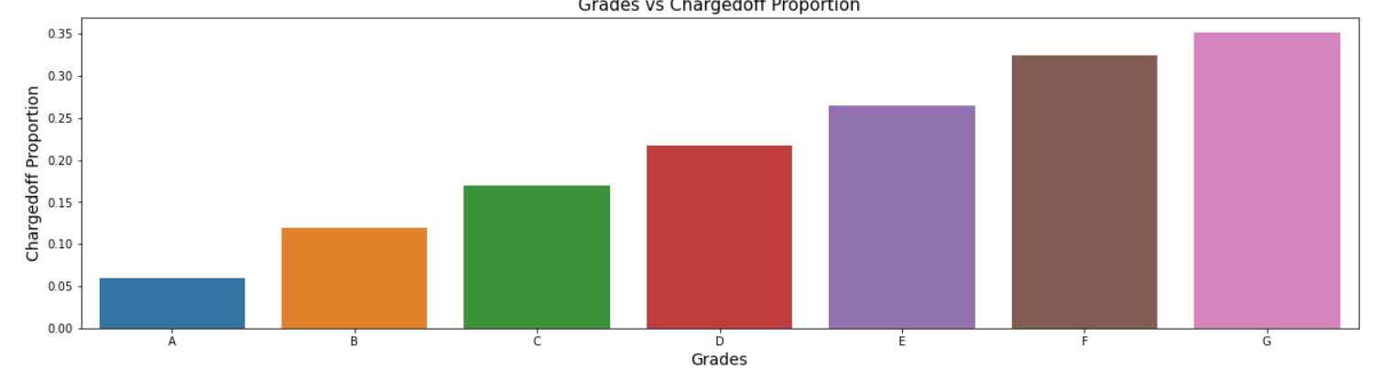
ANALYSIS
Grades are decreasing charged off proportion is increasing.

Slide 8
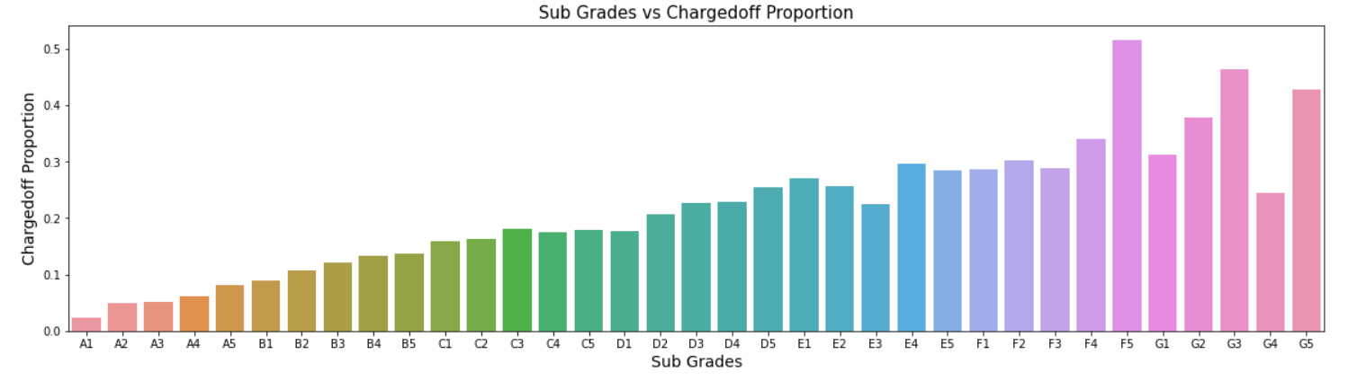
ANALYSIS
Subgrade F5, G3 and G5 are having maximum charged off proportion.

Slide 9
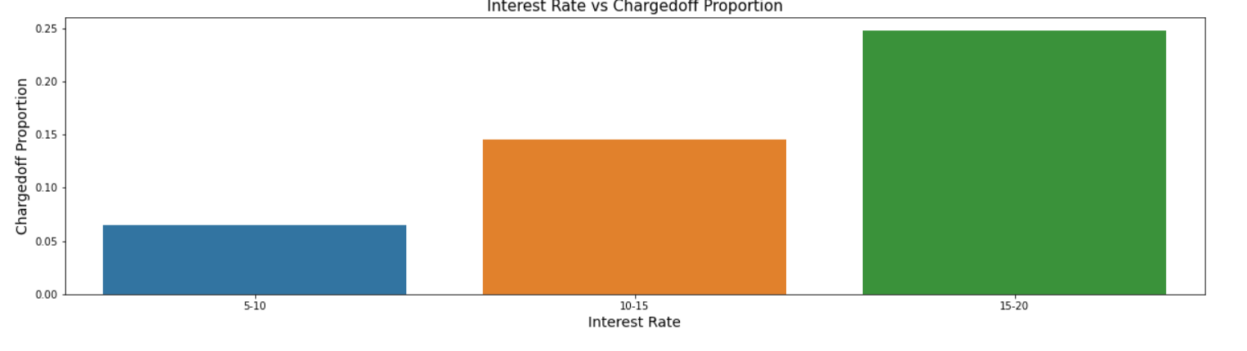
ANALYSIS
As interest rate are increasing, charged off proportion is also increasing. The borrower who takes loan at the interest rate of 15 to 20 are getting mostly charged off.

Slide 10
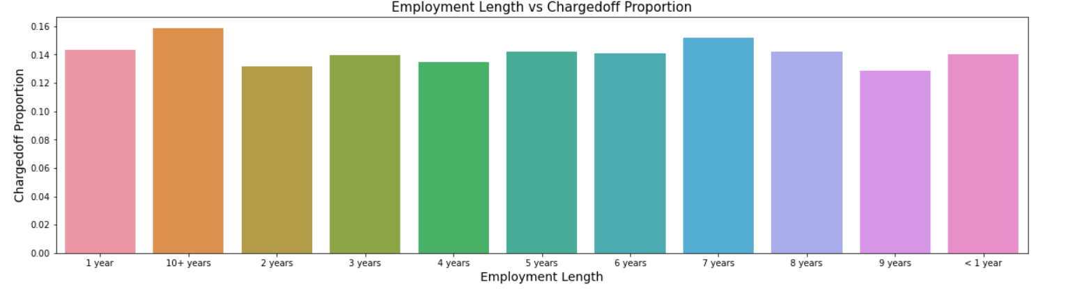
ANALYSIS
The borrowers whose employee length is less than 1 year, 1 year and 10+ year are mostly getting charged off.

Slide 11
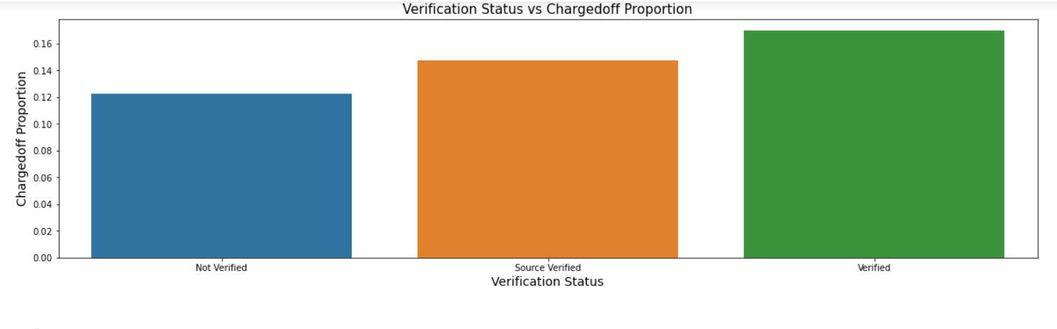
ANALYSIS
Most of the verified borrowers are getting charged off then others.

Slide 12
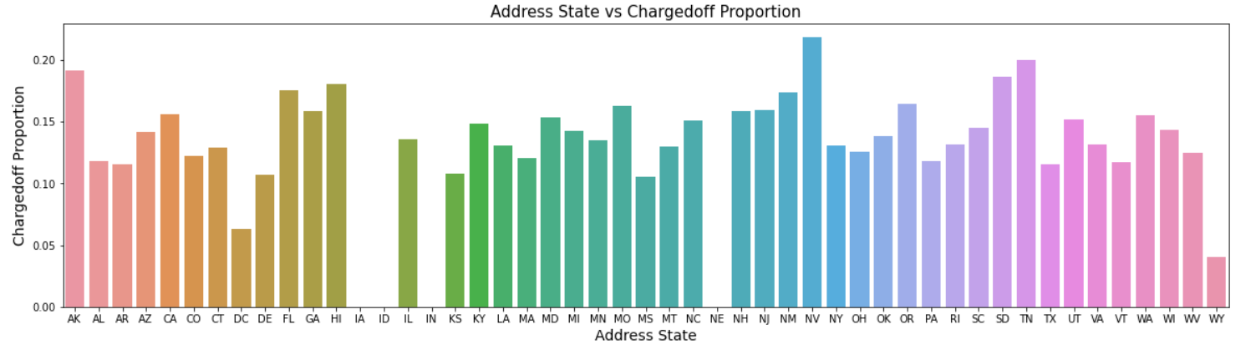
ANALYSIS
The borrowers who are from NV, AK, TN, SD state are mostly getting charged off.

Slide 13
Recommendations
Lending club should reduce the high interest loans for 60 months tenure, they are prone to loan default.
Lending club shouldn't give loan to those borrowers whose loan status is ‘Verified’ as they taken high amount of loan with 60 months tenure.
Borrower’s will be defaulted when they are having home ownership as ‘Rent’ and they take loan for the purpose of debt consolidation for Credit card payments.
Borrower’s whose annual income is low i.e. between 20k are more defaulted.
Lending club shouldn't give loans to those borrowers, who takes loan amount in the range 0 to 14000.
Borrower’s who receive interest at the rate of 15-20%, will be defaulted more.
Borrower who takes loan for the purpose of small business, Debt consolidation and credit card payments are more defaults.
Grades are good metric for detecting defaulters. Lending club should examine more information from borrowers before issuing loans to Low grade (G to A).
Lending Club shouldn't provide loans to these states i.e. NV, AK, TN, SD, as most of the people are defaulted from these places only.
Those borrowers whom employment length is less than and equals to 1 are more prone to defaulter, Lending club should aware of these while giving loans.

